Slide 1
Scenario-Based Case Study Analysis of Asteroid Mitigation in the Short Response Time Regime
Bernie Seery and Kevin Greenaugh
IEEE Aerospace 2018
Big Sky, Montana
March 8, 2018
Image courtesy of NASA
Notes:
The arc of our research project over the last almost 3 years has been to investigate how to deflect a hazardous asteroid by moving its orbital path off an Earth-impacting course – this in the short response time regime, where by short time we mean <10 years to impact, and using impulsive techniques
Kevin and I were the lead agency executives for this joint DOE/NASA partnership, until I retired from GSFC 4 months ago, and I am now with USRA in Columbia Maryland. Kevin is still at NNSA HQs in Washington DC

Slide 2
This talk will discuss the merits of the structured case study approach taken in years 1-2⁺ of our research program
Joint agency NEO mitigation study
Domain of our research
Notional timeline for mitigation
Case study methodology and some results
Look backs about the methodology
Forward work
Acknowledgements
Notes:
This talk will discuss the scenario-based systems engineering methodology employed. I am really just checking in and giving you an update as to where we are with our study.

Slide 3
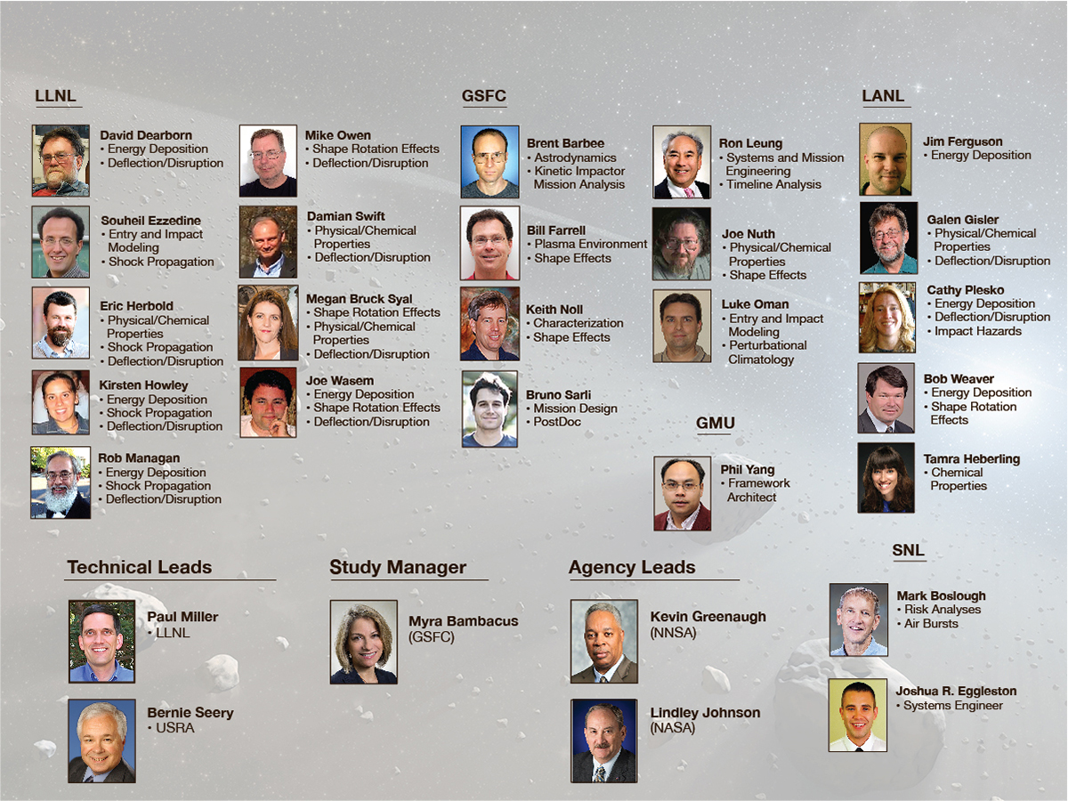

Joint Agency Mitigation Team
3
Notes:
The Team is a blend of 2 DOE nuclear labs, where scientists specialize in the modeling of high pressure shock-dissipation of highly porous matter; NASA interplanetary space mission designers, nuclear payload engineers, big data computer scientists, and of course the Managers.
high pressure shock-dissipation of highly porous matter is biggest uncertainty

Slide 4
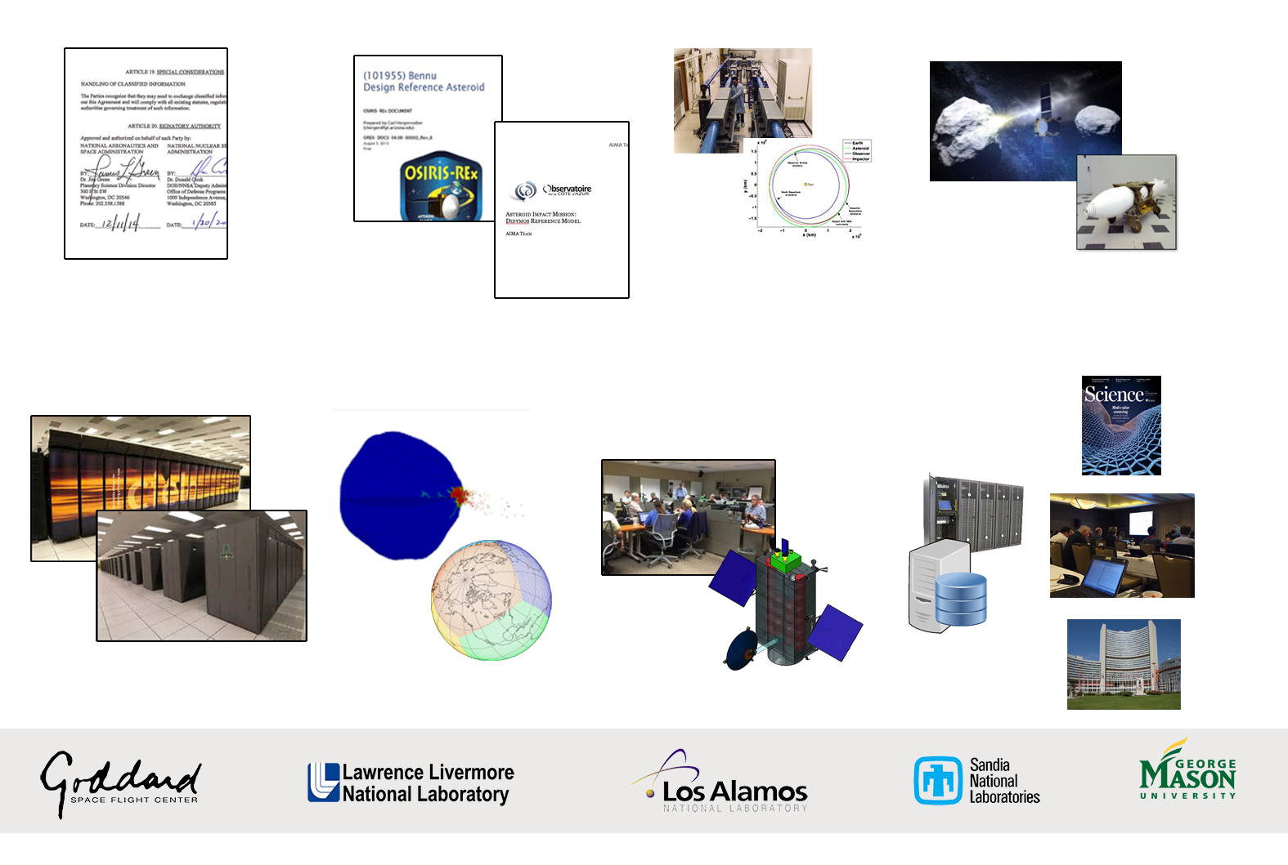
NEO Mitigation Research Project…at a glance
Strategic Partnerships
Small Body
Characterization
Model Input
Engagement Approaches
Peta-Scale
Computing
2-D and 3-D
Simulations
Design Reference
Missions
Repository of
Big Data
Publish
Notes:
Plans, techniques, and procedures for executing planetary defense against incoming NEOs for which the available response time is short is an important component of the overall US preparedness strategy. It is particularly important to be prepared to handle NEOs with diameters between about 50 m and 300 m, as well as comets of various sizes.
Our focus is on impulsive mitigation solutions for medium scale, short warning time scenarios, as well as for longer term
Hydrocodes: solving the elastic plastic conservation equations associated with a model of brittle failure to account for the fracture of the solid material
Supercomputers: Cielo at LANL and Sequoia at LLNL
Trident EOS and opacity experiments on meteoric materials

Slide 5

Planetary Defense Coordination Office
Administrator Associate Administrator
Associate Administrator, Science Mission Directorate
Planetary Science Division Program Director
Public Communications
Lead Program Executive
Planetary Defense Officer
Policy Development
NEO Observation Program Program Manager Program Scientist
Interagency and Emergency Response Program Officer(s)
Mitigation Research Program Officer(s)
Minor Planet Center/IAWN
Center for NEO Studies @ JPL
Catalina Sky Survey
Pan-STARRS
LINEAR/SST
IRTF
GSSR
NEOWISE
SMPAG
ARM Gravity Tractor Demo
DART Mission
Short Warning Mitigation
Interagency coordination
Emergency Response planning
Interagency exercise
Notes:
For context, here we see the PDCO LEGACY program – InterAgency & Emergency Response – Mitigation Research

Slide 6
Notional Timeline for a NEO Mitigation Response
Communications, Independent V&V, Threshold for Decision-Making and Taking Action
International Coordination and Cooperation
Spacecraft(s)
launch
Continuum of
available deflection
times
PHO
Passes threat
threshold and
mitigation mission
preparations begin
In space
rendezvous
with PHO
Time of
un-deflected
Earth
impact
PHO
detected
Terrestrial
mitigation
preparations
activated
Spacecraft, payload
and launcher
preparations begin
Deflection/Disruption
delivery system is
positioned and
prepared for activation
Credit: Brent Barbee’s thesis, UT/Austin, 2005
Notes:
Our emphasis is on shortening the timeline of response, so as not to obviate the kinetic impactor option.
We mostly considered hypervelocity NEO intercept speeds. Note that launch lead time is not the same as warning time, because some amount of time will elapse between when the threatening asteroid is discovered and when we would be ready to launch a spacecraft, as can be seen in the left hand portion of the timeline. Hence the title of our research is the “short response time regime”
Time of flight was constrained to be 1500 days
The yellow band of available deflection times is dictated by several things, such as Earth departure date, flight time, solar phase angle, maximum distance from the sun, intercept speeds needed, etc.
For a 10 yr launch lead time, we found 29 SLS Block 1 with iCPS launch vehicles are required to deflect Bennu by 1.4 Earth radii. Somewhat fewer launches are needed for the 25 year lead time. We used beta equals one in this case.
Changing beta from 1 to 2.5 has a nearly linear effect on the required # of launches.
We found that for a single HAMMER and beta =1, HAMMER in KI mode can adequately deflect a NEO up to 123 m in diameter by 1/4th ER

Slide 7
Case Study 1
Notes:
Scenario analysis, associated impact modeling, and space mission planning illuminate the details of a particular NEO mitigation approach for the short warning/response time regime, and inform decision-makers as to whether kinetic or nuclear momentum delivery systems should be employed to deflect the body
1999 RQ 36 is a roughly spherical, 500 meter B-type carbonaceous asteroid with a one in 2700 chance of impact in the late 22nd century. Being well-studied using remote sensing, it is also the target of the OSIRIS Rex mission, and this returning spacecraft will thus provide in situ data on the object for comparison with what we gleaned remotely early in the next decade. While there is no immediate concern, the impact energy of a collision with Bennu is approaching 1.5 GT, suggesting an interesting study from this perspective as well as the fact that the equatorial gravity is down by a factor of ¼, making it an interesting case for a 3D push
Regional scale object
The graphic is a collage only
At left, log of the specific energy deposited in the 3D Bennu surface. Ablation creates thrust from the expelled mass. In this instance, we sourced the energy along the equatorial region. Notice the shock wave propagating thru the body
The middle graphic is the result of the astrodynamnicist tweaking the orbit of Bennu (modifying the JPL Horizon System-generated ephemeris) so that it is fictitiously Earth impacting on Jan 10th, 2025
assessment model, similar to Reinhardt et al at Stanford

Slide 8
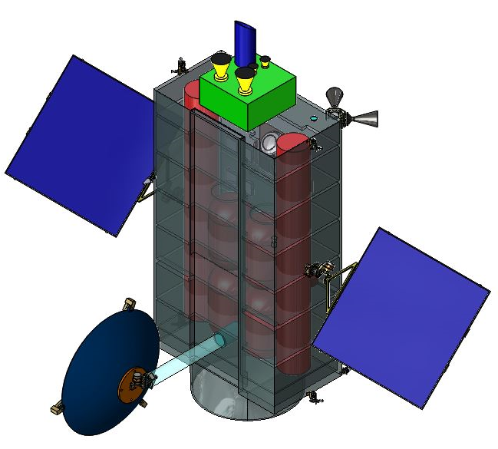
Conclusions from Case Study 1
Despite its relatively low bulk density, Bennu is very large for deflection by a kinetic impactor, as was understood at the outset of this study
Important to generate a detailed and quantitative assessment of how much kinetic impactor mass would be required, along with details such as contingencies and redundancies to increase probability of mission success
Hypervelocity Asteroid Mitigation Mission for Emergency Response (HAMMER) vehicle was designed to accommodate either an impactor or nuclear payload, and its modular structure provided a flexibility that added little to the spacecraft
Study raised important issues with attempting multiple
launches within a relatively short timeframe
We applied scaling techniques to our results for Bennu
to assess for what size asteroids our HAMMER KI would
be practical in preventing Earth impacts
Notes:
HAMMER was designed to max out the payload carrying capability of a Delta 4 Heavy, at around 8 metric tons, with a Kton pyload. It is a threshold device for asteroids approximately 140 m in scale.
Prioritized Order of Importance for Canonical Parameters:
Orbit, mass, shape (density), strength**, spin, composition, internal structure, porosity
** if nuc, then composition ranks higher

Slide 9
Joint publications documenting Case Study 1
Notes:
Our peer review approach has been twofold: first, dueling nuclear lab models and table top reviews, followed by joint, peer-reviewed publications.

Slide 10

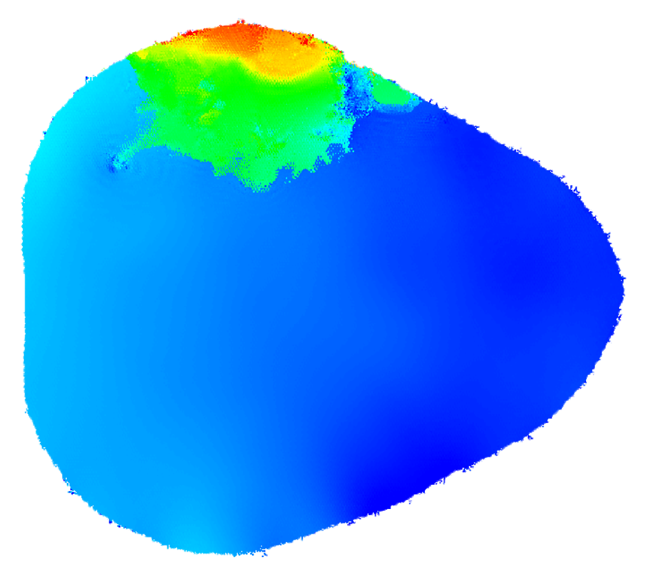
Case 2: Didymos B
Cases 2 and 3 explore asteroid shape effects on kinetic and nuclear deflection
Case 3: Comet Churyumov-Gerasimenko
β ~ 1.25
Y-axis
t = 0.09 s
X-axis
β ~ 1.65
Red: v > 100 m/s
Blue: v < 5 cm/s
Short warning time for comet may require larger 𝚫v delivery. Calculating shape effects on both kinetic and nuclear cases.
Momentum delivery ~ 30% greater for impact along X-axis
Credit: Megan Bruck Syal (LLNL)
Notes:
Comets are less frequent, but more dangerous targets, in that long period, eccentric comets are typically moving fast and are not bright enough to detect until they are say 1 year out from perihelion, resulting in shorter warning times than are generally available for NEOs. We need sufficiently energetic interplanetary launch systems available on short call-up. Being able to launch on vehicles like the SLS with higher C3 opens up access to more intercept/rendezvous trajectory options, as their motion around the Sun makes them extremely difficult to reach with s/c..
Didymoon = 150 meter diameter object
Likely spherical or oblate spheroid
S Type, like Itakowa
Complex spin-orbit coupling of both bodies
Beta is the momentum boost factor; Ppush /P impactor
Supports APL/Double Asteroid Redirection Test (DART) Project with KI model output
When impact is on axis, 2-D modeling suffices
SOB is most likely to be used for a body whose competance is unknown, or if time between decision and impact is limited. Close bursts deliver momentum more efficiently, while increasing the potential for disruption
Keyhole – locations on close approach leading to a resonant impact at a future close approach
Comet 67P is 3.1 km radius and the smallest KBO ever seen (Pluto is the largest)
Jupiter-like comet (eccentric and inclined)
Density about 0.5 gm/cc
Because strata have been observed, theory is that it was formed by a collision of two halves at about 1 m/sec
Comet 67P is a Jupiter family comet, originally from the Kuiper Belt, with a current orbital period of 6.45 years, a rotation period of 12 hours, and a max heliocentric velocity of 135,000 Km/hr
Size scaled down to 215 x 205 m, and physically model it using comet-like chemistry and physical properties (eg., bulk density of 0.5 g/cc)
Concentrate on modeling nuclear deflection/disruption methods

Slide 11
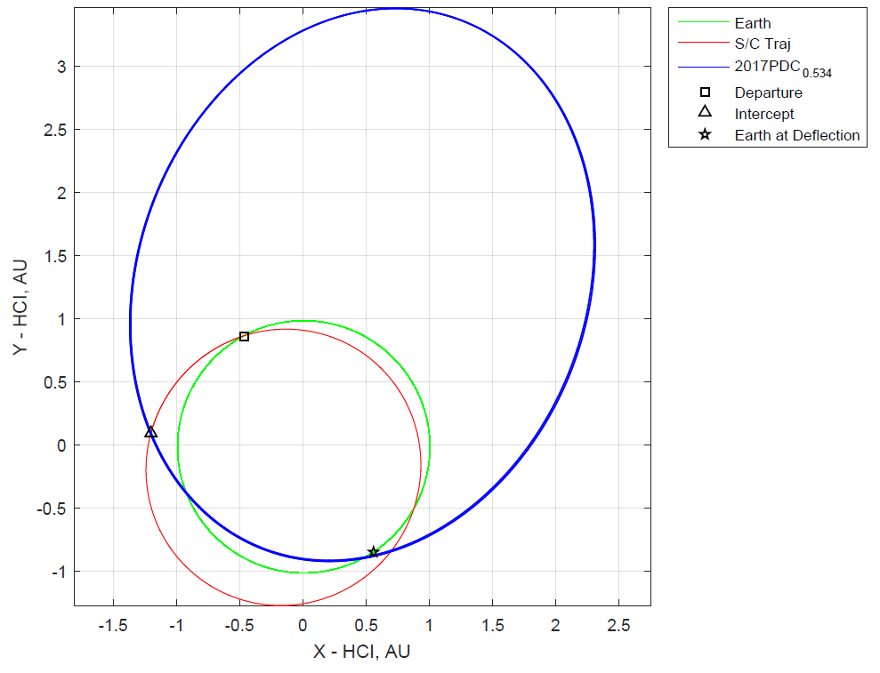
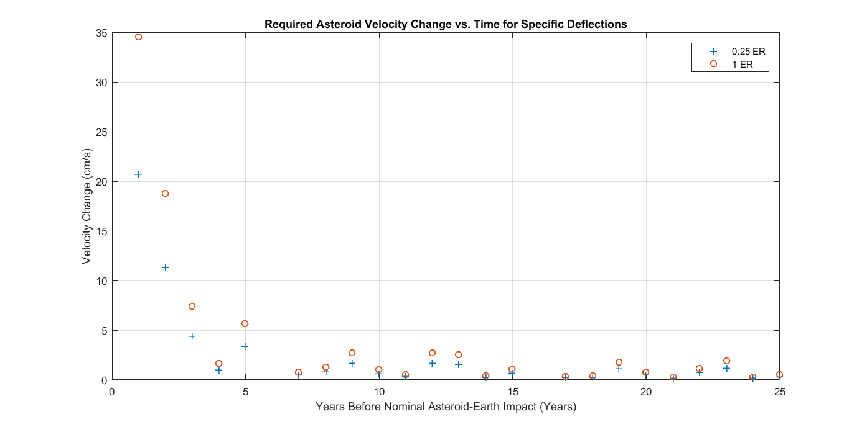
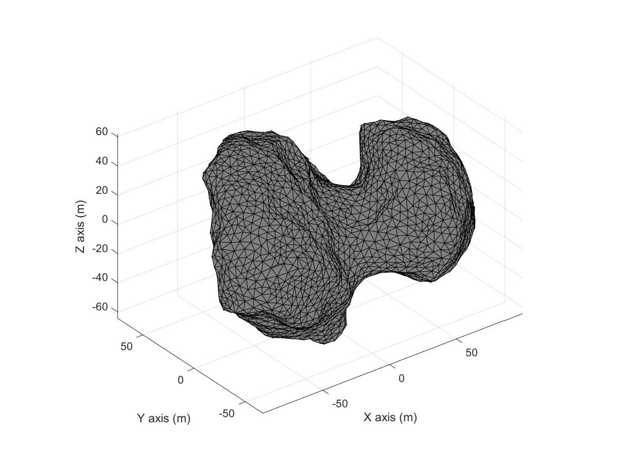
Case Study 3: 2017 PDC / Comet 67P
Pre-defined 2017 PDC orbit, Rosetta-provided Comet 67P shape model
This case study represents an important step towards considering the more difficult hyperbolic comet scenarios
Comet Orbit Parameters
Semi-major axis --- 2.24 au
Eccentricity --------- 0.6
Inclination ---------- 6.23°
Example Optimal Spacecraft Intercept Trajectory For
Deflection
Credit: Brent Barbee (GSFC)
11
Notes:
Comet orbit eccentricity makes rendezvous more difficult, but allows successful deflections with relatively low applied Δv, which reduces risk of accidental comet break up (Δv < ~10% esc. vel.). Deflection appears equally feasible with a kinetic impactor or standoff nuclear detonation. We have looked at low thrust options for performing a kinetic impact deflection of an object which is on a very eccentric orbit around the sun, and to do so such that the object’s perihelion speed is increased by the kinetic impact. Highly enabling

Slide 12
NEO mitigation modeling matrix
Case #
Target NEO
Spacecraft Model
Kinetic Impact
Nuclear Deflection
Nuclear Disruption
(Robust dispersal)
(500m)
Sub-
Surface
Surface
Standoff
Sub-
Surface
Surface
Standoff
1
Bennu (500m)
Sphere
✓
✓
(160m)
2
Didymos
Secondary
Dart (CAD)
✓
✓
(300m)
3
Scaled
Comet GC
(Inc. volatiles)
Hammer
(CAD)
■
■
■
■
Legend:
✓
= Complete
■
= Planned
Notes:
C-T-C began with spherical ball targets because there are subtle differences in the physics within the various codes. For example, one might use Eulerian mechanics while other uses Lagragian. Differences are also observed in terms of whether they used a mathematical fixed mesh, no mesh, or an adaptive one. Additional differences were noted in how each modeled material strength.

Slide 13
Communication between the science and engineering teams is facilitated by formal requirements documents
Device to Target Sequence (DTS)
Mission Characteristics (MCs)
Payload Physics (LANL, LLNL)
Payload Engineering (SNL)
Mission Design Lab Reports (MDL)
Mission Design (NASA)
Final Requirements Descriptions
Payload and Mission-Specific Requirements
Focused Studies on the DRA Problem
The requirements documents assure a harmonized mission design
Credit: Cathy Plesko (LANL)
Notes:
NASA presents the design reference asteroid. The teams do their own discipline-focused studies to determine a solution to the aspects of the problem that they are responsible for. The results of these focused studies are then harmonized into the Mission Characteristics (MC) document, a short outline of important design priorities and mandatory features. MDL details launch vehicle, trajectories, environments, etc. FINALLY, harmonized into a detailed, lengthy requirements document called the Device-to-Target Sequence (DTS). Speaking as an ex-NASA executive, the two cultures do things surprisingly in the same way

Slide 14
Take Aways
Our research thrust is a comprehensive, scenario-based approach, providing a platform for addressing the integrated problem
14
Notes:
Scenario analysis helps determine whether undesireable operational impacts arise under particular architecture choices when the system is stressed in complex ways. Nuclear deflection is insensitive to many of the details, so that the amount of push available makes the mitigation action quite robust, and the concern shifts to whether the asteroid is disrupted.
Nuclear momentum delivery approach will excel with larger scale or less competent bodies, and in general has certain systems advantages for situations with high degrees of uncertainy in the physical parameters. Kinetic methods work in certain instances, such as with smaller scale, more competent bodies.
Gravity tractor and KI success rates improve with earlier detection of potential impactors
Earlier detection will in turn provide more lead time to plan and execute a mission
KI is essentially like trying to shoot one bullet out of the air with a much smaller one.
The gravity tractor idea is more subtle. The gravity tractor method leverages the mass of the spacecraft to impart a gravitational force on the asteroid, slowly altering the asteroid's trajectory.
One of the main challenges is how to transmit the impulse required (possibly quite large), to an asteroid of unknown mass, composition, and mechanical strength, without shattering it into fragments, some of which might be themselves dangerous to Earth if left in a collision orbit. The gravity tractor solves this problem by gently accelerating the object as a whole over an extended period of time, using the spacecraft's own mass and associated gravitational field to effect the necessary deflecting force. Because of the universality of gravitation, affecting as it does all mass alike, the asteroid would be accelerated almost uniformly as a whole, with only tidal forces (which should be extremely small) causing any stresses to its internal structure.
A further advantage is that a transponder on the spacecraft, by continuously monitoring the position and velocity of the tractor/asteroid system, could enable the post-deflection trajectory of the asteroid to be accurately known, ensuring its final placement into a safe orbit.
all that is required is that the vehicle thrust in a consistent direction relative to the asteroid's trajectory, and that neither the vehicle nor its expelled reaction mass come in direct contact with the asteroid. The tractor spacecraft could either hover near the object being deflected, or orbit it, directing its exhaust perpendicular to the plane of the orbit. The concept has two key advantages: namely that essentially nothing needs to be known about the mechanical composition and structure of the asteroid in advance; and that the relatively small amounts of force used enable extremely precise manipulation and determination of the asteroid's orbit around the sun. Whereas other methods of deflection would require the determination of the asteroid's exact center of mass, and considerable effort might be necessary to halt its spin or rotation, by using the tractor method these considerations are irrelevant.

Slide 15
National Near-Earth Object Action Plan
Detecting And Mitigating the Impact of Earth-bound NEOs (DAMIEN) Interagency Working Group and the development of the forthcoming National Near-Earth Object Action Plan
The NASA/NNSA joint team contains the necessary expertise to support actions needed to enhance national preparedness for handling threatening NEO scenarios
Notes:
The NASA/NNSA joint team is supporting both DAMIEN and the development of the forthcoming National Near-Earth Object Action Plan. This DAMIEN and associated NEO National Preparedness Action Plan effort began as an outgrowth of the National Science & Technology Council and the Committee on Homeland and National Security.

Slide 16
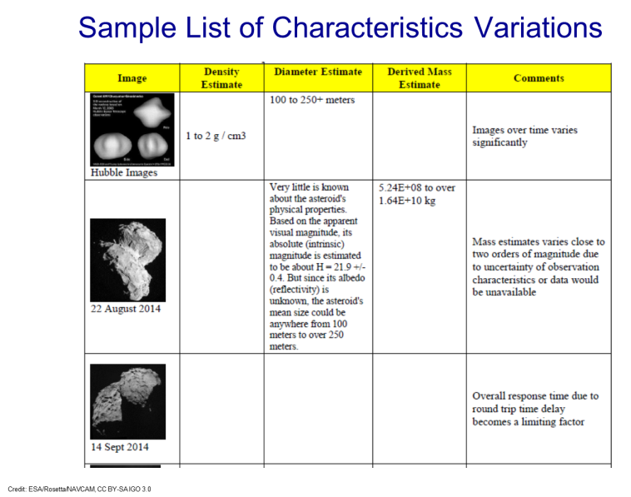
Remote sensing observations of small bodies do not yield reliable shape models – reconnaissance precursor?
Builds on work reported at the 2017 IEEE Aerospace Conference, Session 2.2016, 2017 PDC, and the recent Acta Astronautica article entitled, “Options and Uncertainties in Planetary Defense: Mission Planning and Vehicle Design for Flexible Response”
future work will focus on our uniqueness space – ie., nuclear mitigation concepts:
Very irregular shape and surface topography
Challenging object physical properties, chemistry, rotational state, porosity, composition, C.G., etc
Response Time (inc. characterization/recon)
Will explore combining RECON with mitigation utilizing nuclear energy deposition mitigation
Credit: Ron Leung (GSFC)
16
Notes:
Our work thus far is based on direct ascent hypervelocity trajectories for delivering the maximum mass or NED to target; suffice it to say, any recon information would go a long way towards increasing the probabillity of success for a mitigation mission, given all of the uncertainties involved
Suggested Key Points:
Delay at 1.6 AU is about ~13.25 min
Recon missions can either be flybys or rendezvous, with the latter enabling much more characterization data
Top parameters for recon: mass, density, composition, trajectory, shape
Recon Payload: high spatial resolution imager, high spectral resolution spectrometer, bistatic radar sounder, in situ geotechnical measurements (strength/porosity)
The best ground and space-based observations of Comet 67/P suggested that it should be a solid bi-pyramidal shaped body
Leverages NNSA and NASA team breadth and unique skills in modeling of energy deposition into these objects. Unique capability in specific NED techniques.
Broader community is likely to continue to contribute into Kinetic and other techniques such as lasers, Ion repulsive, Yarkovsky effect, etc. while the NNSA / NASA team provides niche analysis and modeling skill set.
Several mission are already attempting to data within the RECON domain. These include DART and OSIRIS-REx. An area not yet fully explored is the combining RECON together with mitigation utilizing nuclear “like” energy deposition mitigation techniques.

Slide 17
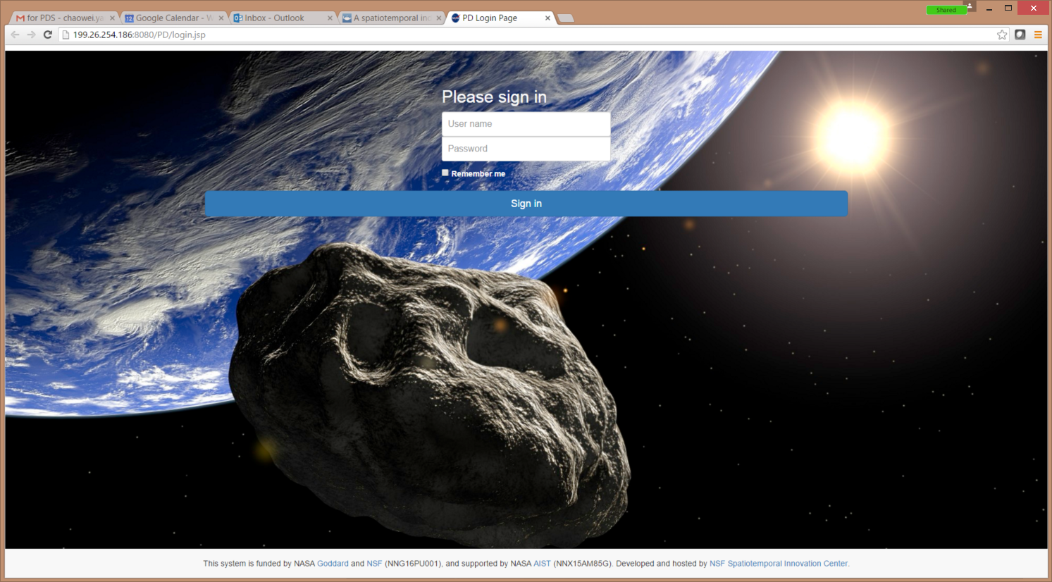
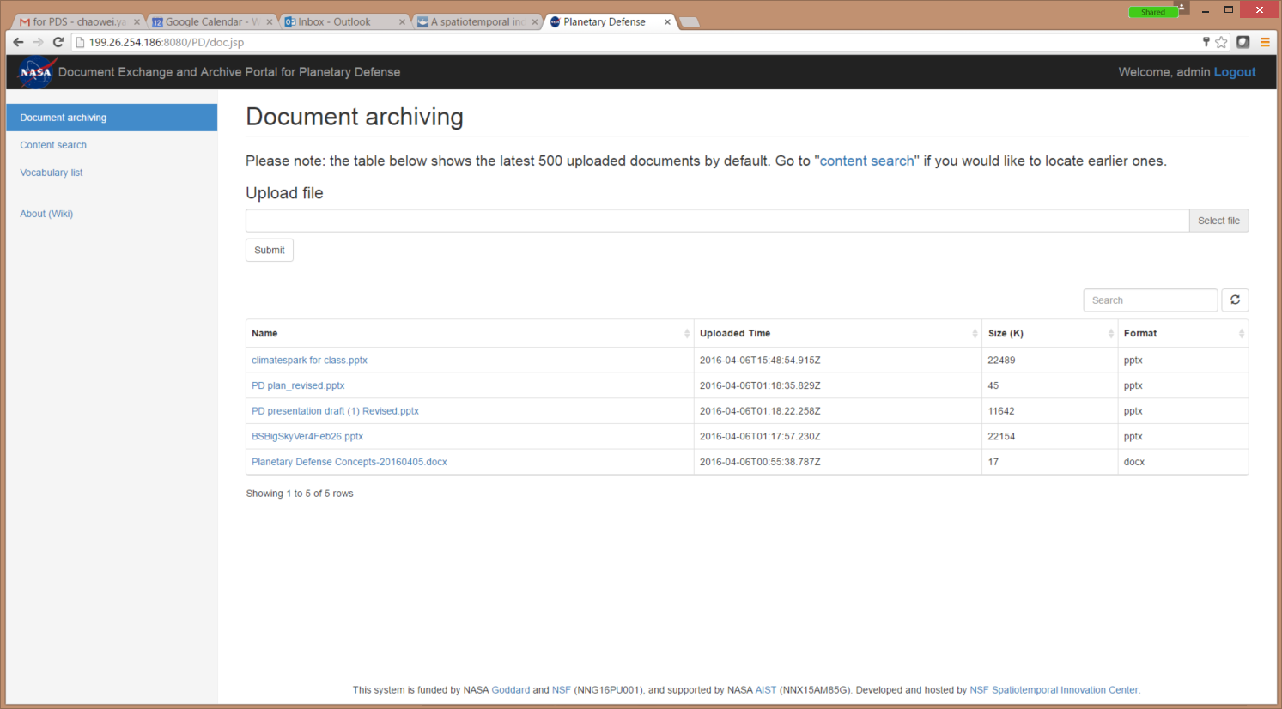
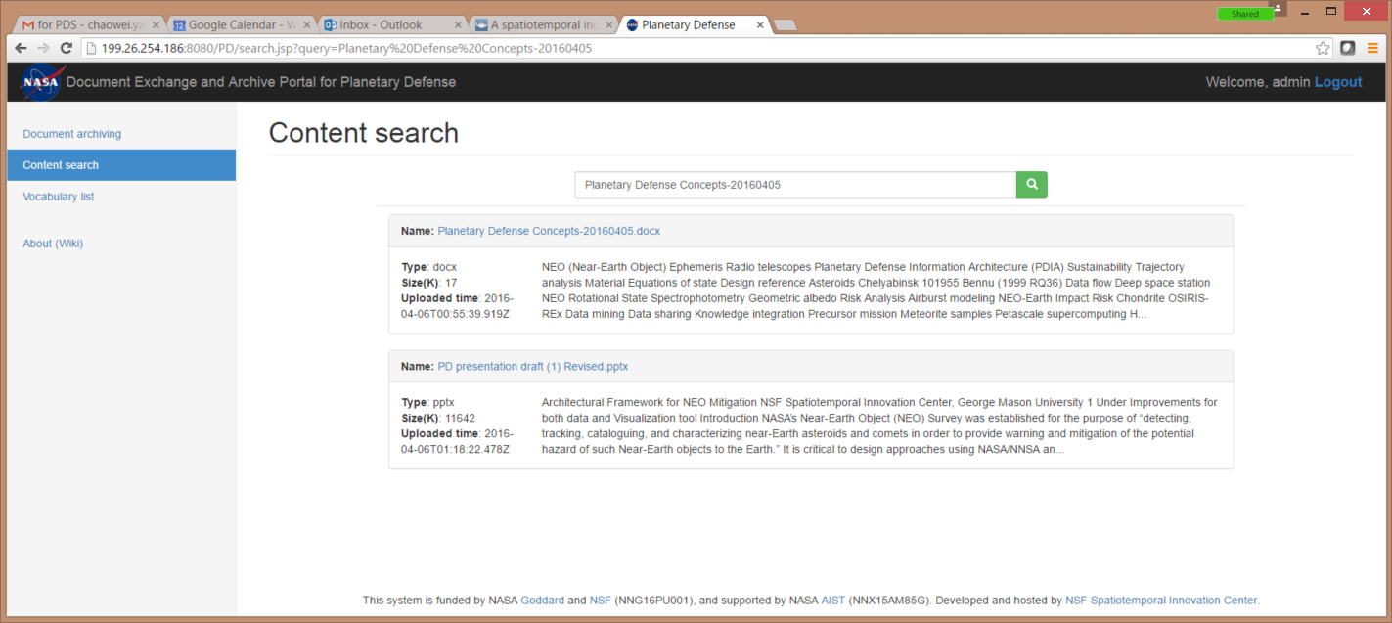
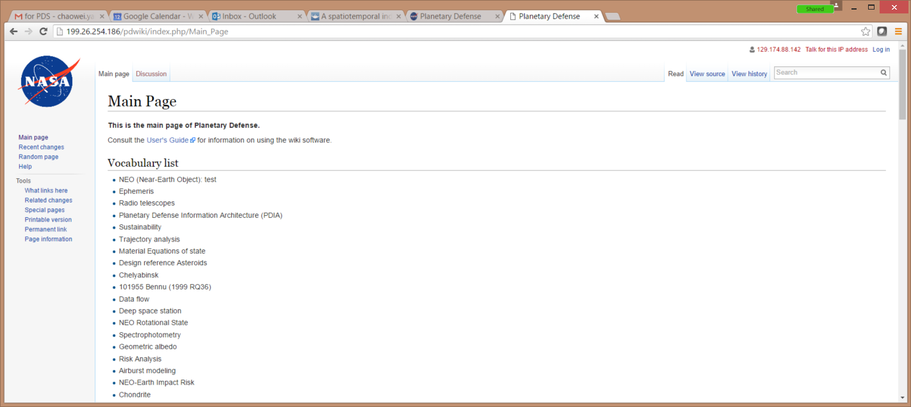
PD Framework Portal, semantics, search engine, ontology, 4D visualization, etc… a clearing house for mitigation strategies
Credit: Phil Yang (GMU)
Notes:
In the long run, we need an architecture for facilitating collaborations and integrating capabilities to achieve the most effective, executable options for mitigation. We are developing a cyberinfrastructure for capturing mitigation trades, analyses, model output, risk projections, and mitigation mission design concepts
Maintain/Operate an evolving vocabulary list to address the syntax/semantics problem for information discovery
Develop a knowledge base & search engine for NEO mitigation resources
Investigate a knowledge reasoning model for potential mitigation by assimilating existing scenarios
Investigate a 4 dimensional visualization tool based on new datasets and existing tools
By combining big data with high-powered analytics, it is possible to recompute a risk scenario model in shorter time interval. Perscriptive analytics – what to do by providing information on optimal decisions based on future scenarios

Slide 18
Forward Work
Complete the Planetary Defense Framework Portal so that it becomes the repository/clearing house for current and future mitigation DRA/DRMs and modeling efforts
Examine the systems implications and notional design for a reconnaissance spacecraft in support of the National NEO Preparedness Strategy and Action Plan
Focus on the nuclear deposition concepts going forward for Case Study 3 and beyond, as efforts in this area may be limited for the broader community
Complete the full Device-To-Target (DTS) document to wrap up the full, end to end systems analysis
Debate and define the next couple of case studies
Notes:
The uncertainties in the asteroid response can be thought of as uncertainty in initial conditions. We strive to develop accurate modeling using select problems. We then apply these models to scenarios that span the anticipated range of possibilities, and look for similarities and differences in the results. Sensitivities to parameter variations can then be explored. Combining an understanding of the potential parameter ranges with the sensitivities provides an understanding of the parameters that dominate the overall modeling uncertainty. If overal lrisk estimates are desired, then the info can be used as input to a PRA type tool

Slide 19
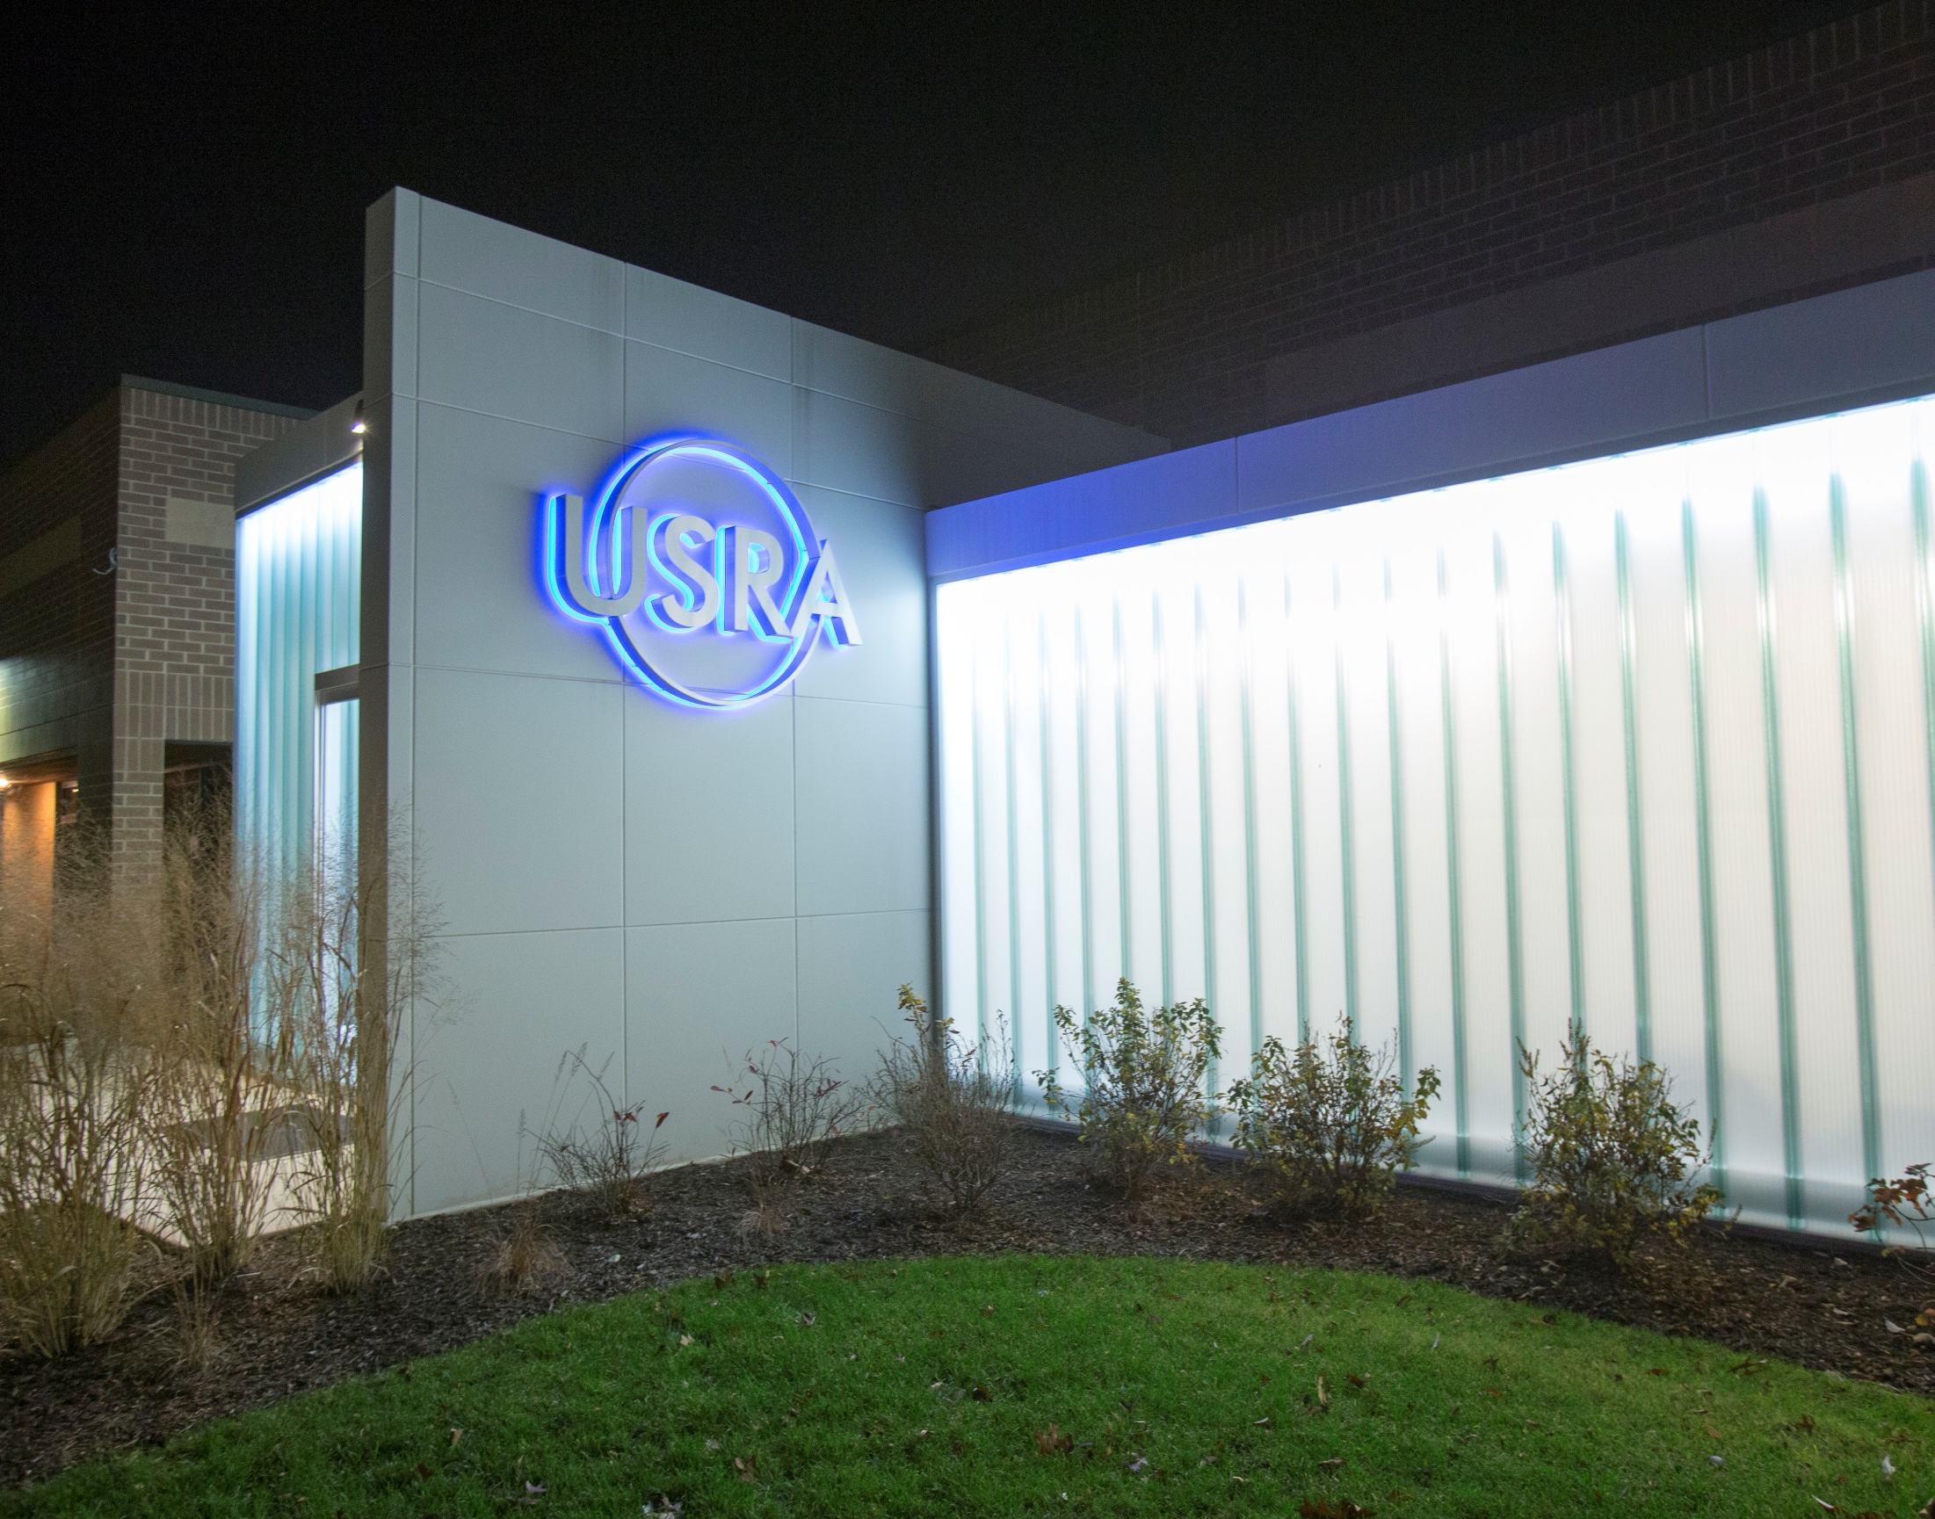
Thanks to NNSA Defense Programs and NASA’s Planetary Defense Coordination Office for their support

Slide 20
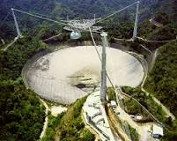
Arecibo

Slide 21
Credit: Planetary Society

